Slide 1
Bitmap Image Encryption and Decryption Task 3
Aniket Dere
Matriculation Number: 60334138

Slide 2
Introduction
This report outlines the process of encrypting and decrypting text messages within bitmap images using a basic form of steganography in Java. The method employed hides a message by manipulating the least significant bits of pixel values in the image. This approach ensures minimal visual alteration of the original image, preserving its appearance while embedding secret information.

Slide 3
Methodology
Encryption Process
Message Preparation: The text message is converted into a binary format, representing each character as an 8-bit binary code.
Image Selection: A bitmap image is chosen as the medium for hiding the message. This image serves as the carrier of the hidden information.
Pixel Manipulation: The least significant bit (LSB) of certain pixel values (specifically, the blue color values) in the image is modified. Each bit of the binary message replaces the LSB of the pixel's blue component.
End-of-Message Marker: An end marker (a specific binary pattern) is appended at the end of the message to indicate where the message concludes. This prevents the decryption process from reading past the actual message.
Image Output: The modified image, now containing the hidden message, is saved as a new bitmap file.

Slide 4
Decryption Process
Image Input: The modified bitmap image is loaded into the Java program.
Message Extraction: The program reads the LSB of the blue component of each pixel, reconstructing the binary string.
End Marker Detection: The extraction process stops upon detecting the predefined end marker, ensuring only the actual message is read.
Binary to Text Conversion: The binary string is converted back into human-readable text.
Output: The decoded message is displayed and can be saved to a text file.

Slide 5
Conclusion
This basic steganography technique in Java demonstrates a straightforward method of hiding and retrieving messages within bitmap images. While effective for non-sensitive use, it's important to note that this method is not secure against determined attempts to uncover the hidden message. For more secure or robust applications, advanced techniques and encryption should be considered.

Slide 6
Implementation
The implementation uses Java, leveraging its standard libraries for image manipulation (javax.imageio.ImageIO) and file handling. The primary methods involved are:
extractHiddenMessage: Reads pixel data from the image, extracts the LSBs, and assembles the binary string until the end marker is encountered.
binaryToString: Converts binary data to a string.
writeToFile: Writes the extracted message to a text file.

Slide 7
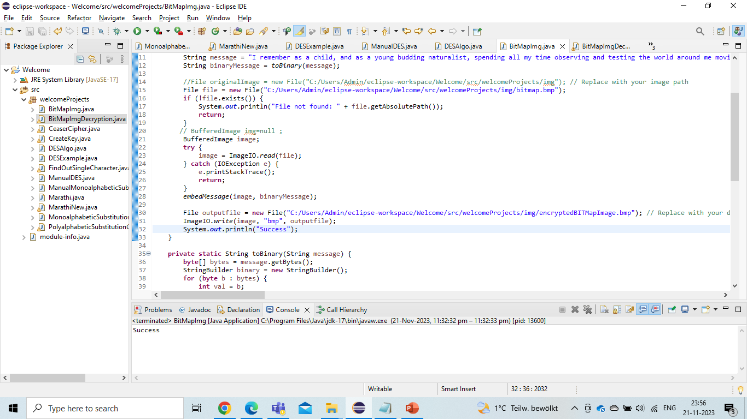
Corresponding SS shows th code of reading file from the file system and function toBinary() to convert text into binary data.

Slide 8
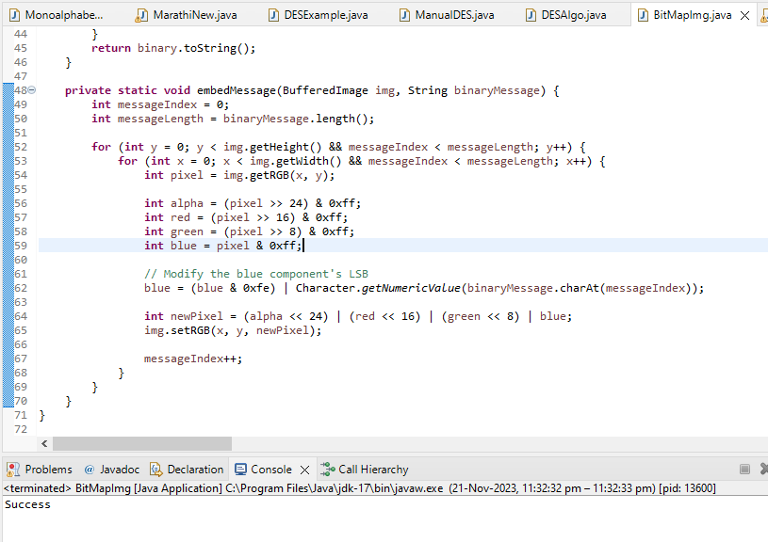
The function iterates over the pixels of the image.
For each pixel, it extracts the color components (alpha, red, green, blue).
It modifies the LSB of the blue component to match the current bit of the binary message.
The pixel's color is then updated in the image with the new blue value.

Slide 9
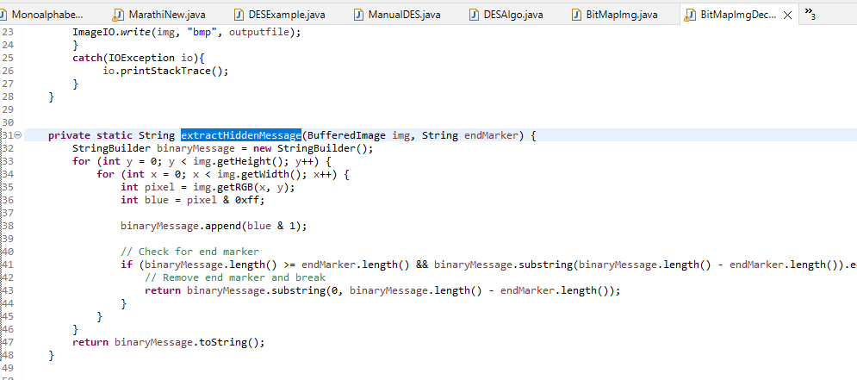
The function iterates over the pixels of the image.
It then iterates over each pixel in the image, from left to right and top to bottom.
For each pixel, it retrieves the blue component of the pixel’s RGB value. In an RGB color, the blue component is represented by the least significant 8 bits of the pixel’s integer value. The bitwise AND operation (&) with 0xff is used to isolate these 8 bits.

